Slide 1


“Exploratory Data Analysis
pada Data E-Commerce”
Mini Project EDA
Bootcamp Data Science
Sarah Octavia

Slide 2

Outline
05 Conclusion
04 Visualization
03 Exploratory
02 Preprocessing
01 Dataset Interpretation
By Sarah Octavia

Slide 3
01 Dataset Interpretation
Dataset: Sales data in 3 different supermarkets
The dataset contains historical sales data from a supermarket company's 3 branches over 3 months, reflecting the increasing growth of supermarkets in major cities and high market competition.
Invoice id
Branch
City
Customer type
Gender
Product line
Unit price
Quantity
Tax 5%
Total
Date
Time
Payment
Gross margin percentage
Gross income
COGS
Rating
By Sarah Octavia

Slide 4





02 Preprocessing Data
PYTHON LIBRARY
for data processing and manipulating numerical data
for data processing
for more complex visualization types
for quick visualization
By Sarah Octavia

Slide 5
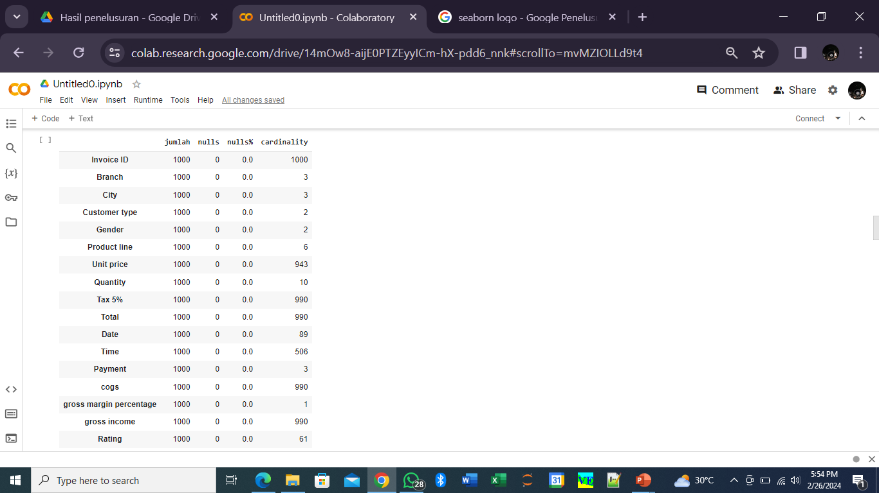
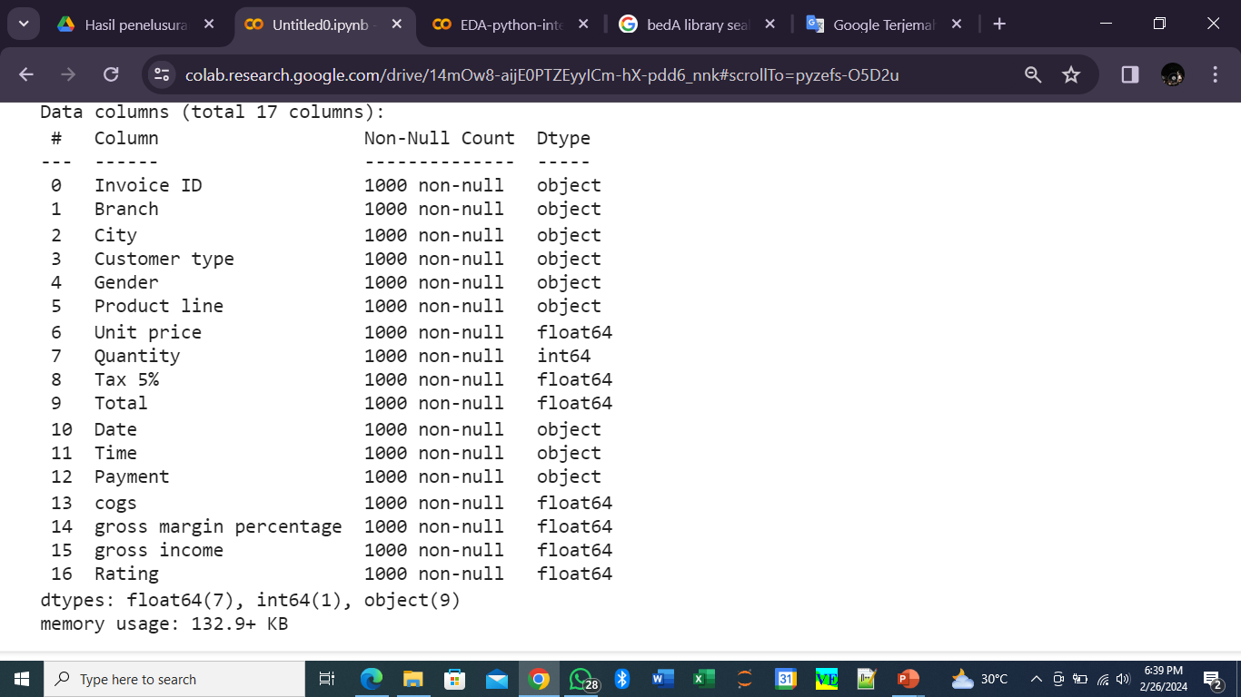
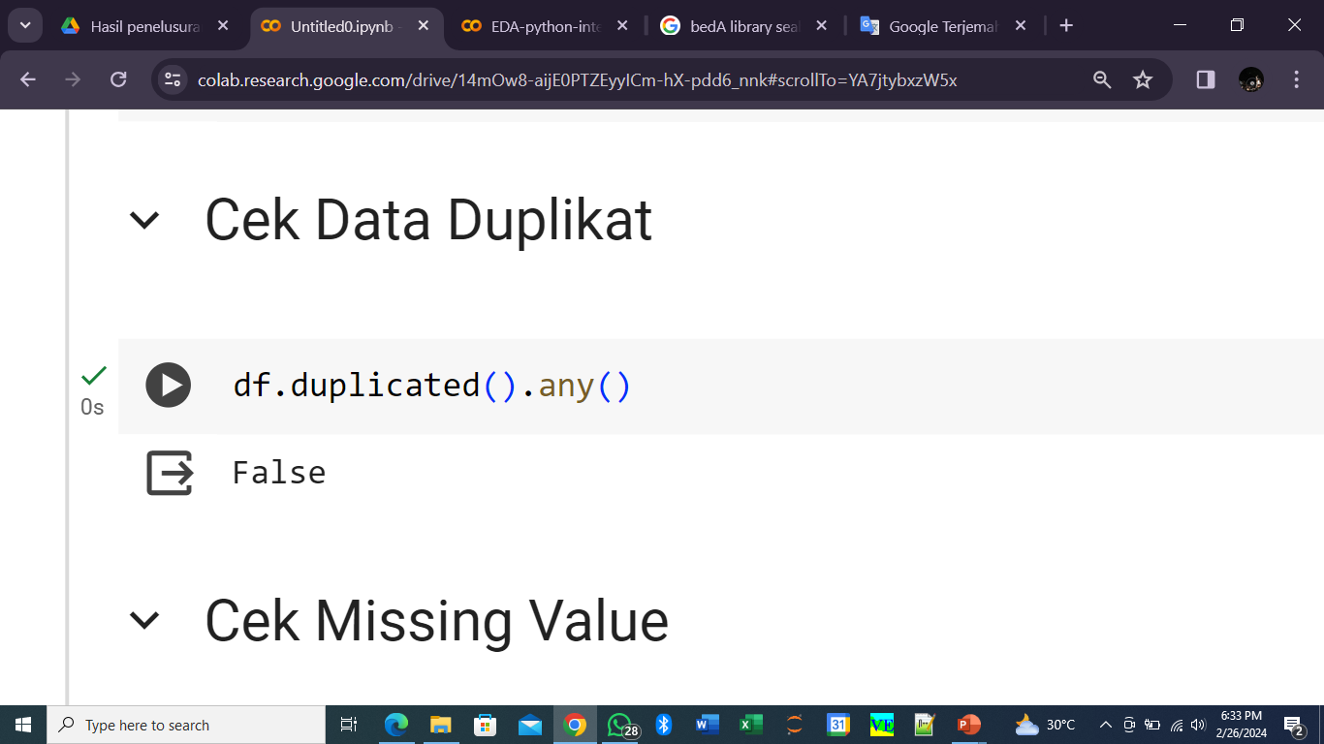
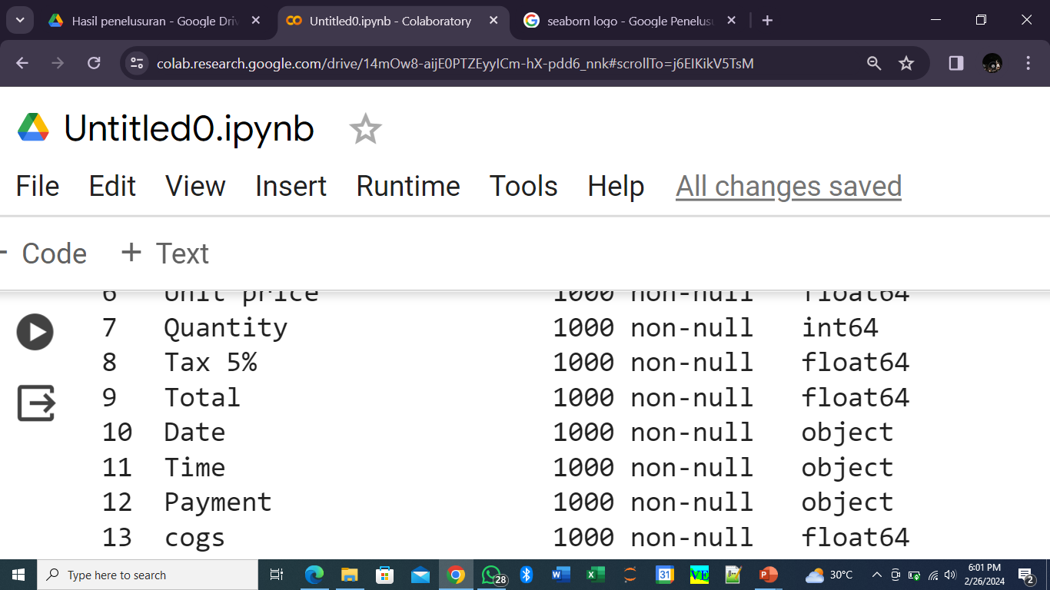
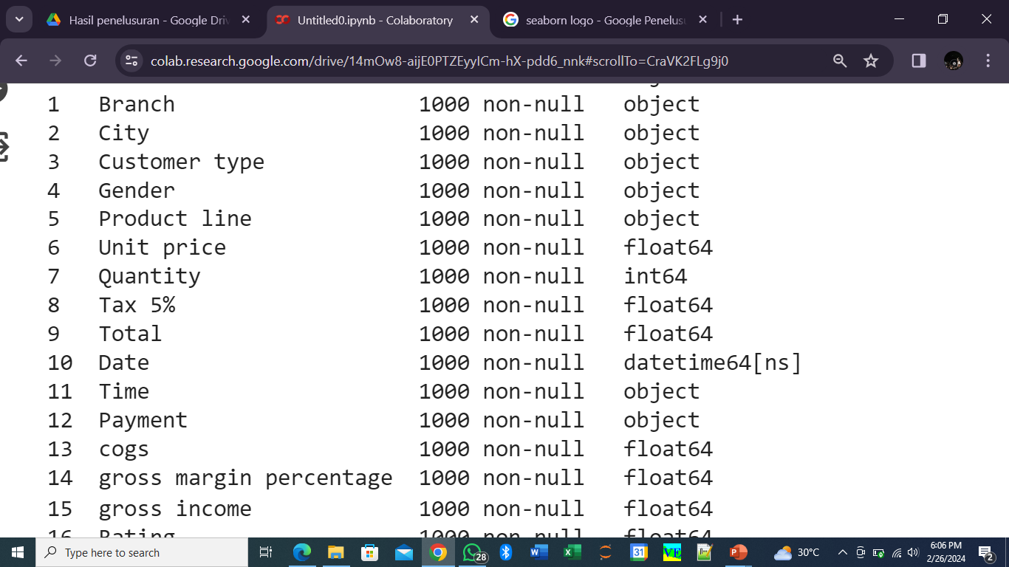
03 Explanatory Data
Check the data
Check missing value
Check duplicate
Change the date format
By Sarah Octavia

Slide 6

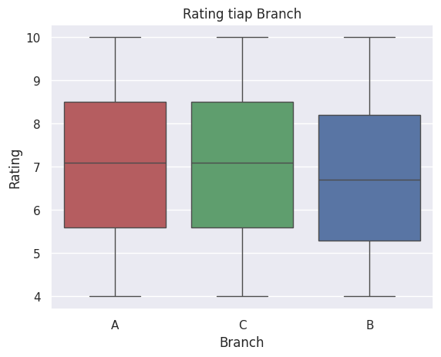
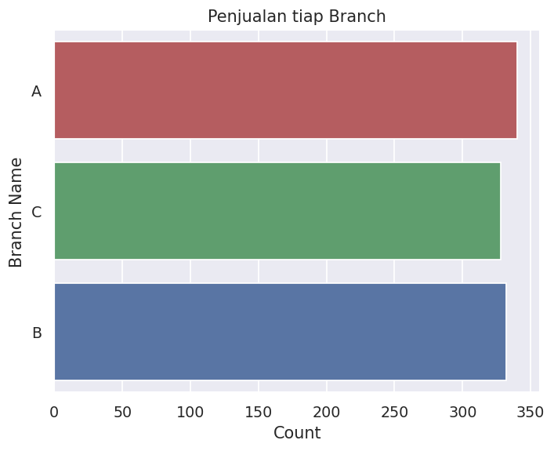
04 Data Visualization
Branch A has the best performance in terms of ratings and sales. Branch C has the lowest performance in terms of ratings and sales. Branch B performs in the middle in terms of ratings and sales.
By Sarah Octavia

Slide 7
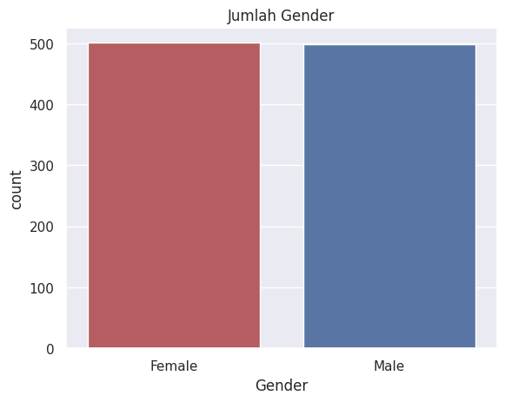
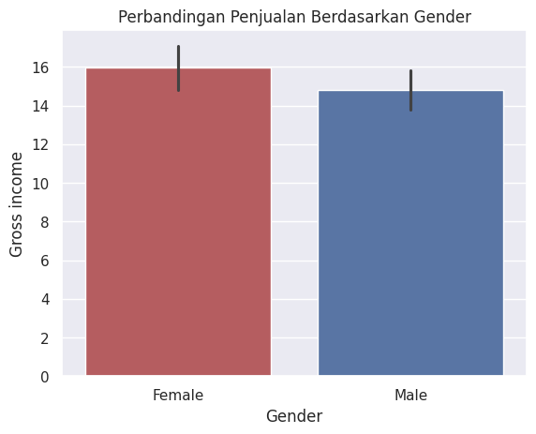
04 Data Visualization
The number of men and women in the combined sales data for the 3 branches is comparable, but female customers provide greater gross income for sales than male customers
By Sarah Octavia

Slide 8
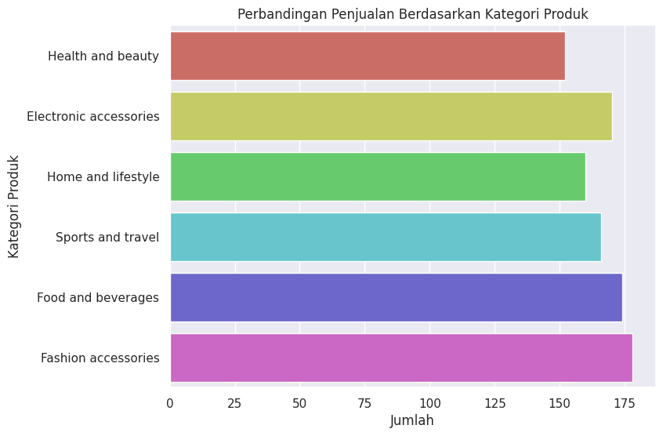
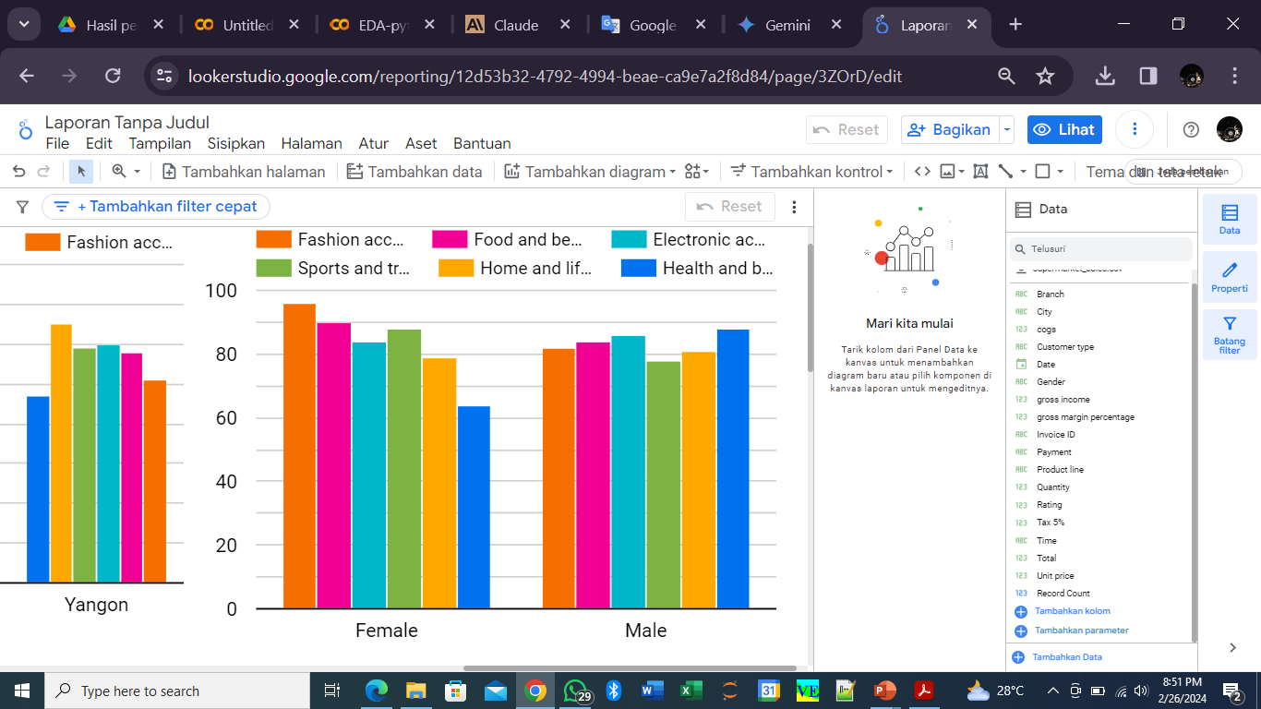
04 Data Visualization
Overall, fashion accessories are the commodity with the highest sales, followed by food and beverages in second place. Among women, fashion accessories have become popular products. while men prefer to buy electronic and health commodities
By Sarah Octavia

Slide 9
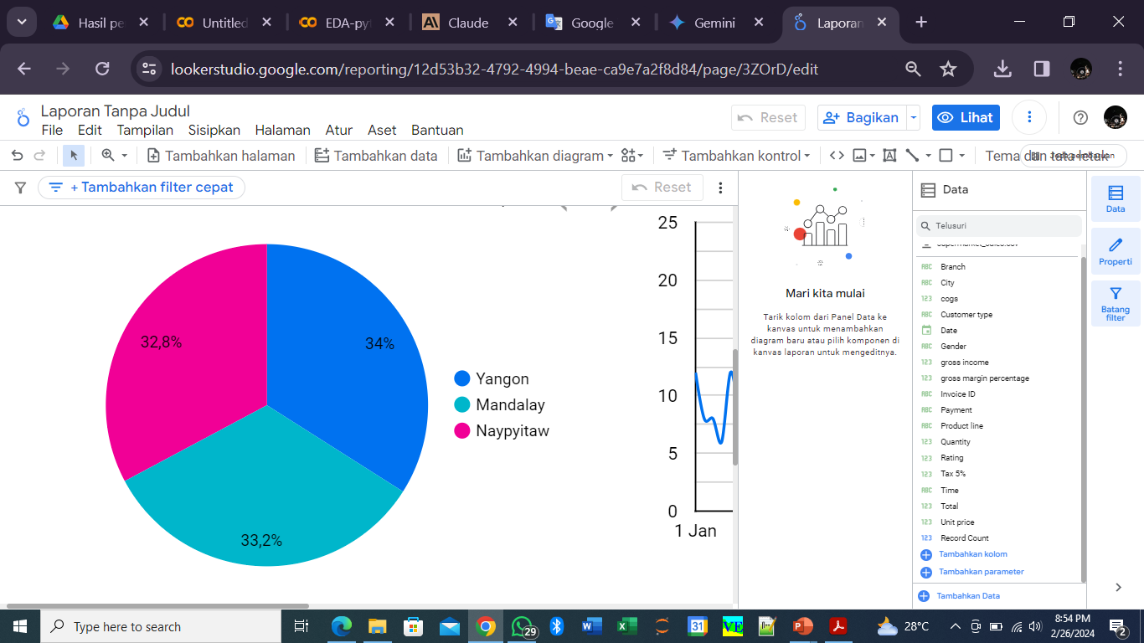
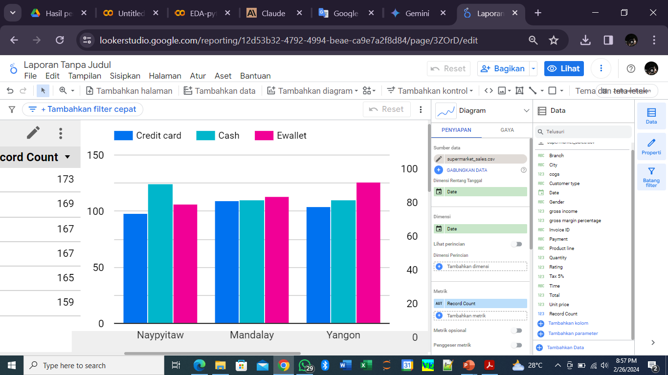
04 Data Visualization
There are 3 sales branch areas with a balanced sales proportion in the range of 33-34%. Buyers at Naypyitaw branch mostly use cash payment methods, buyers at Yangon use e-wallet, while buyers in Mandalay use 3 payment methods equally
By Sarah Octavia

Slide 10
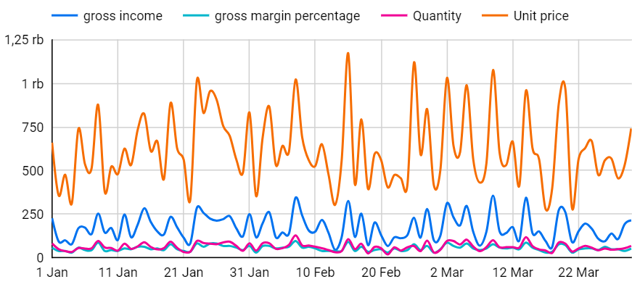
04 Data Visualization
Gross Income and Gross Margin Percentages ⬆️
Because
Quantity and Unit Price ⬆️
In general, these four parameters are interrelated and influence each other. An increase in one parameter (for example quantity or unit price) will have an impact on increasing other parameters (gross income and gross margin percentage), assuming other parameters remain constant
By Sarah Octavia

Slide 11
04 Data Visualization
https://lookerstudio.google.com/reporting/12d53b32-4792-4994-beae-ca9e7a2f8d84
https://colab.research.google.com/drive/14mOw8-aijE0PTZEyyICm-hX-pdd6_nnk?usp=sharing
Looker Studio
Google Colab
By Sarah Octavia

Slide 12
05 Conclusion
From the data processing and visualization that has been carried out, there are recommendations for increasing sales:
Target promotions based on gender preferences (fashion for women, electronics for men).
Optimize payment methods and enhance in-store experience to improve branch ratings.
Maintain stock availability to increase gross income and gross margin percentages, leverage fixed pricing as higher prices may reduce demand.
By Sarah Octavia

Slide 13


Thank You
Contact me on
https://www.linkedin.com/in/sarah-octavia
sarahoctav12@gmail.com

